Slide 1

Analyzing Unstructured Data
March 17th 2018

Slide 2
Agenda
Unstructured vs. Structured Data
Conventional Text Analysis
Basics of neural network
Deep Learning
CNNs - Image Recognition
Drug Discovery
Source: https://www.laserfiche.com/ecmblog/4-ways-to-manage-unstructured-data-with-ecm/

Slide 3
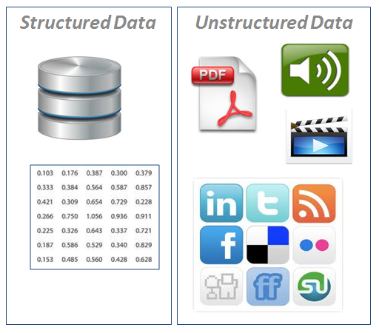
Structured vs. Unstructured Data
Structured Data
Databases
Unstructured Data
Social Media
Audio
Video
80% of business related information originates in unstructured format, primarily text
Source: https://www.laserfiche.com/ecmblog/4-ways-to-manage-unstructured-data-with-ecm/

Slide 4
Text Analysis - Overview
Text Data
Stem Documents
Aspect & Entity
Check Data Quality
Term Document Matrix
Topic Modeling
Split into Sentences
Add Other Features
Split into Words
Sentiment Analysis
TDM + Other Features
Remove Punctuations
Remove Stop words
Example: The new iPhone X has excellent screen resolution, but, it’s price is very high

Slide 5
Text Analysis - Techniques
Pre-Processing:
Tokenization
Lemmatization
N-Grams
POS Tagging
NER (Named Entity Recognition)
Sentiment Analysis
TF * IDF
Supervised Vs. Unsupervised
Stanford Core-NLP
LingPipe
SentiWordNet
Topic Modeling
LDA (Latent Dirichlet Allocation)
DMR (Dirichlet Multinomial Regression)
Evaluation
Comparison vs. Humans
Typically text analytics models are evaluated against humans-assigned values
More than one correct answer possible

Slide 6
Text Analysis - Techniques
Pre-Processing:
Tokenization
Lemmatization
N-Grams
POS Tagging
NER (Named Entity Recognition)
Sentiment Analysis
TF * IDF
Supervised Vs. Unsupervised
Stanford Core-NLP
LingPipe
SentiWordNet
Topic Modeling
LDA (Latent Dirichlet Allocation)
DMR (Dirichlet Multinomial Regression)
Evaluation
Comparison vs. Humans
Typically text analytics models are evaluated against humans-assigned values
More than one correct answer possible
How to capture the context?

Slide 7
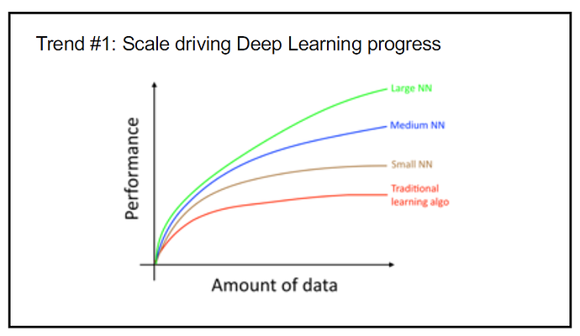
Deep Learning vs. Scale
Reference: Deep Learning Specialization (Andrew Ng)

Slide 8
Machine Learning vs Deep Learning
Machine Learning to Deep Learning
Machine learning
uses algorithms, parses data, learns from data and predicts
limited to human fed inputs
Deep learning
continually analyzes data to draw conclusions, like us!
structures algorithms in layers to create an artificial “neural network” that can learn and make intelligent decisions on its own
Deep learning is a subfield of machine learning.

Slide 9
Deep Learning
Hierarchical learning
anything is a concept defined in relation to simpler concepts, defined in relation to more simpler concepts and so on…
hence can analyze even unstructured data!
Technically:
A stack of layers of neurons!
or
Deep Neural Network
https://towardsdatascience.com/applied-deep-learning-part-1-artificial-neural-networks-d7834f67a4f6

Slide 10
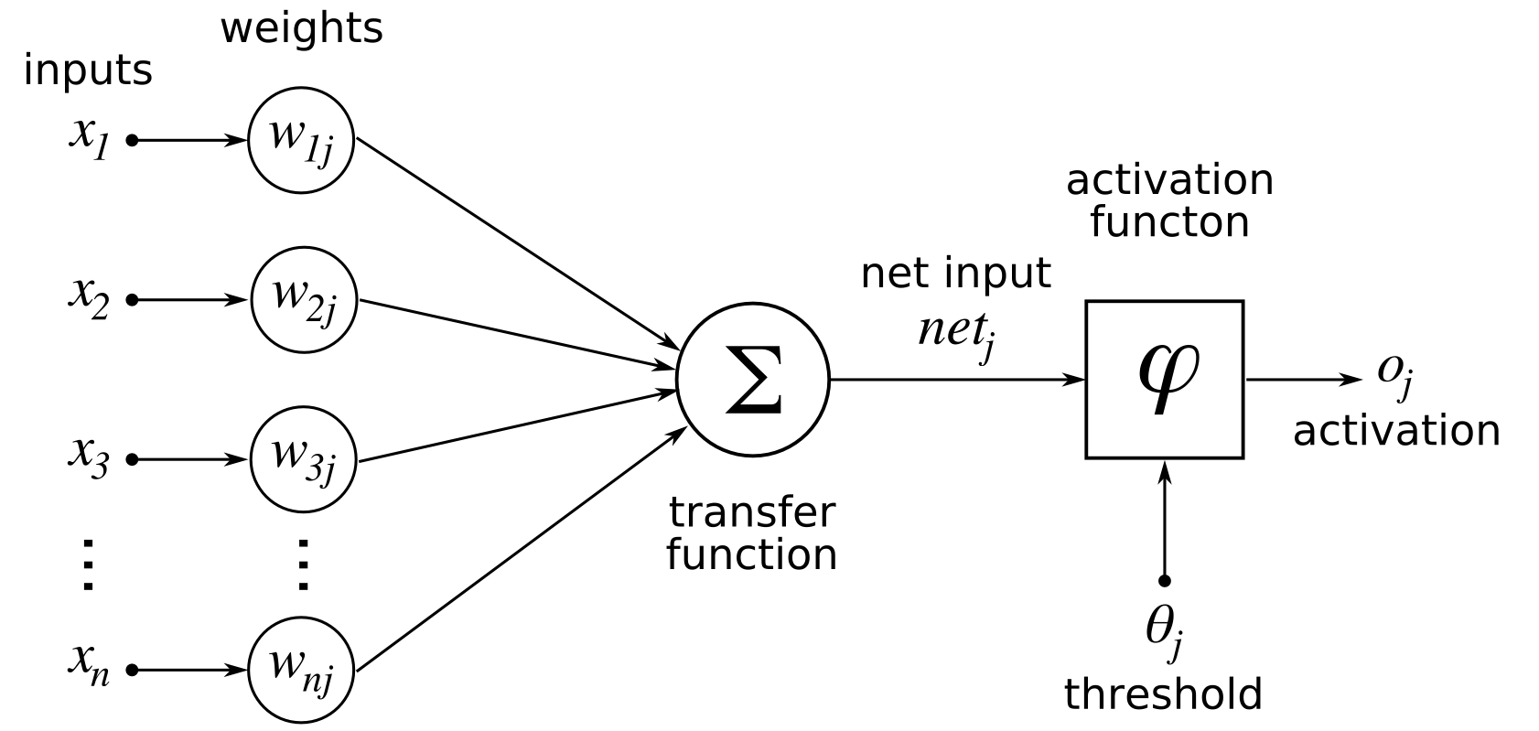
A simple neuron!
Prediction = 𝝈 (Weights * Inputs + Bias)
Source: https://commons.wikimedia.org/wiki/File:NeuronModel_deutsch.svg

Slide 11
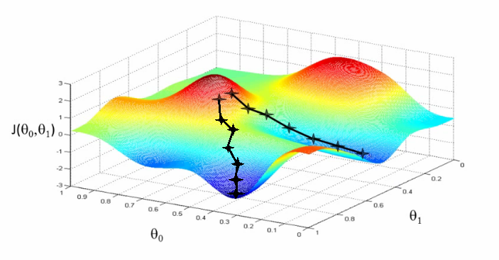
Training in neural network
Score input
Prediction = 𝝈(Weights * Inputs + Bias)
(Sigmoid [0, 1])
(tanH [-1, 1])
(ReLU [0, x])
(Leaky ReLU [0.1x, x])
Calculate loss
(Mean Squared Error for continuous outputs)
(Logistic loss for classification)
Apply Adjustments to weight
(Gradient descent)
(RMS prop)
(Adam Optimizer)
https://medium.com/ai-society/hello-gradient-descent-ef74434bdfa5

Slide 12
Deep Neural Networks
Forward Propagation
Weight Matrix for Layer 1
Z Layer 1
Weight Parameter for Layer 2
Z Layer 2
Weight Parameter for Layer 3
Z Layer 3
Weight Parameter for Layer L
Z Layer L
Input
Activation Layer 1
Activation Layer 2
Activation Layer 3
Activation Layer L
……......
Derivative of Z Layer 1
Derivative of Z Layer 2
Derivative of Z Layer 3
Derivative of Z Layer L
……......
Derivative of
Activation Layer 1
Derivative of
Activation Layer 2
Derivative of
Activation Layer 3
Derivative of
Activation Layer L
Backward Propagation
Derivative of weights Layer 1
Derivative of weights Layer 2
Derivative of weights Layer 3
Derivative of weights Layer L
Reference: Deep Learning Specialization (Andrew Ng)

Slide 13
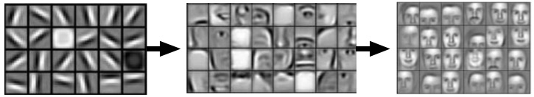
Convolutional Neural Network
A subclass of Deep Neural Network
Mimics object identification by Human
Constrained architecture to:
Leverage temporal and spatial structure of domain
Reduce computation
Excels at understanding complex concepts as a
combination of smaller and smaller pieces of information!

Slide 14
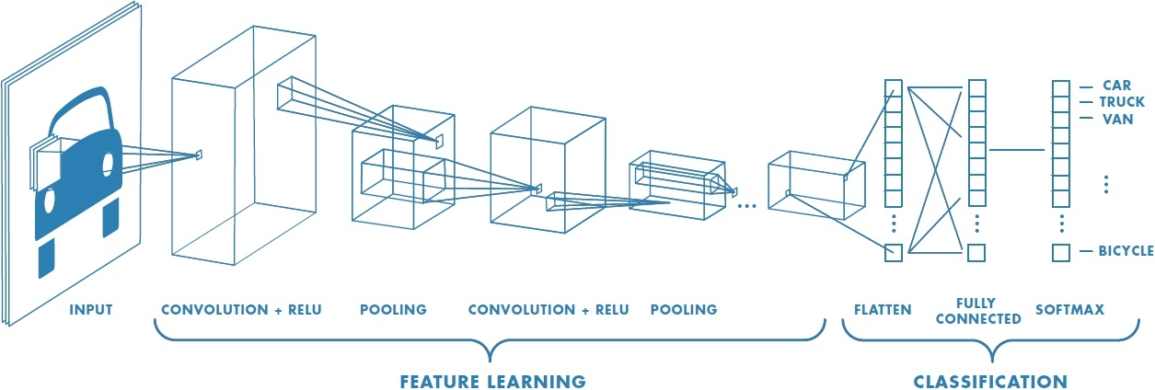
CNN/ ConvNet
Source: https://it.mathworks.com/discovery/convolutional-neural-network.html
Notes:
Only a portion of image is taken, not every neuron is connected to every other neuron
Local connections: Convolution
Layering: Shared weights
Spatial invariance: Pooling or subsampling

Slide 15
Algorithm CNN
INPUT: Training dataset T, say images with labels
TRAINING
For every image in T, do
Create Input Vector for neural network
(20* 20 RGB image has input array length of 20* 20* 3)
Collect all Features
For every feature in Features, do:
CONVOLUTION
POOLING
ACTIVATION
Collect all the output matrices
FULLY CONNECTED LAYER: Transform into one D array
PROBABILITY CONVERSION using SOFTMAX
OUTPUT LABEL = Label with max probability value
Find ERROR using LOSS FUNCTION
Find weight update (delta W) and BACK PROPAGATE to update weights
Trained model can do classification of new data.

Slide 16
AtomNets
Deep CNN based
Structure based drug design
Drug Design:
Target Protein
Ligands to targets
Design ligands that are binders
Learning:
DUD-E dataset
Recognize basic chemical structures on its own
like Hydrogen bonding, Carbon structures.
Candidate treatment for Ebola, awaiting animal trials!
Notes:
For any data with meaningful space orientation

Slide 17
Deep Learning Resources/References:
Machine Learning – Andrew Ng https://www.coursera.org/learn/machine-learning/home/welcome
Deep Learning – Andrew Ng https://www.coursera.org/specializations/deep-learning
Convolutional Neural Networks http://yann.lecun.com/exdb/lenet/
Deep Learning http://deeplearning.net/
Deep Residual Learning https://arxiv.org/abs/1512.03385
Automated Image Captioning - Andrej Karpathy https://cs.stanford.edu/people/karpathy/sfmltalk.pdf
The Unreasonable effectiveness of RNNs - Andrej Karpathy http://karpathy.github.io/2015/05/21/rnn-effectiveness/
Machine Learning 101 - https://docs.google.com/presentation/d/1kSuQyW5DTnkVaZEjGYCkfOxvzCqGEFzWBy4e9Uedd9k/preview?imm_mid=0f9b7e&cmp=em-data-na-na-newsltr_20171213&slide=id.g168a3288f7_0_58
Machine Learning Mastery - https://machinelearningmastery.com/
Wikipedia - https://en.wikipedia.org/

Slide 18
Thank You!
Questions?
Feedback at: bit.ly/XconfTalkFeedback

